Slide 1
Simple Sorting Algorithms
EECS 233

Slide 2
Basics of Sorting
Array data structure
Ground rules:
  sort the values in increasing order
  sort “in place”, using only a small amount of additional storage
Terminology:
  position: one of the memory locations in the array
  element: one of the data items stored in the array
  element i: the element at position i
Goal: minimize the number of comparisons C and the number of moves M needed to sort the array.
  comparison = compare the keys of two elements
  move = copying an element from one position to another

Slide 3
Defining Methods for Sorting
In Java, we can put them in a Sort class that is simply a collection of methods
  public class Sort {
    static void bubbleSort(int[] arr) {
      ...
    }
    static void insertionSort(int[] arr) {
      ...
    }
    ...
  }
We never create Sort objects. All of the methods in the class must be static
Outside the class, invoke them using the class name:
  e.g., Sort.bubbleSort(arr);

Slide 4
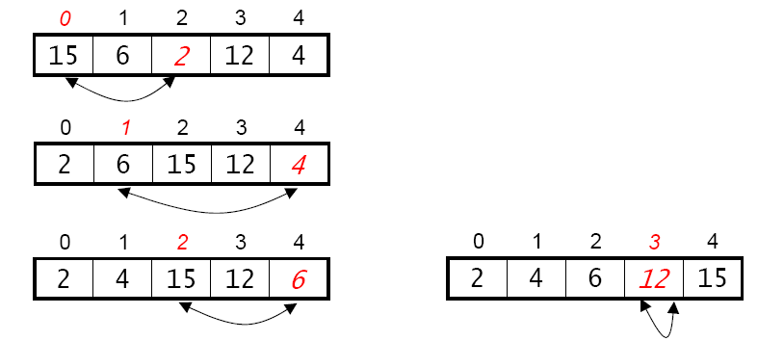
Method 1: Selection Sort
Basic idea:
  consider the positions in the array from left to right
  for each position, select the element that belongs there and put it in place by swapping it with the element that’s currently there
An example:

Slide 5
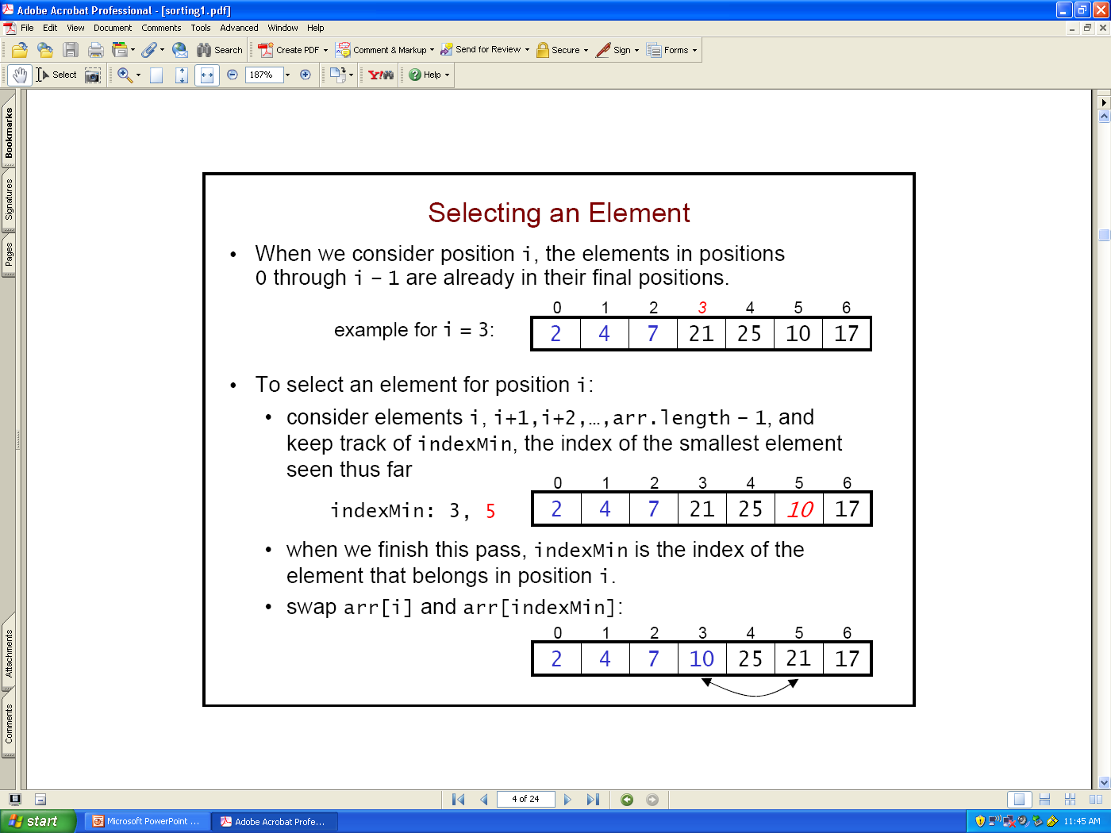
Selecting An Element
When we consider position i, the elements in positions 0 through i – 1 are already in their final positions.
To select an element for position i,
  consider elements i, i+1,i+2,…,arr.length – 1, and keep track of curIndexMin, the index of the smallest element seen thus far
  when we finish this pass, curIndexMin is the index of the element that belongs in position i.
  swap arr[i] and arr[curIndexMin]:

Slide 6
Implementation of Selection Sort
The sort method is very simple:
  static void selectionSort(int[] arr) {
    for (int i = 0; i < arr.length – 2; i++) {
      int j = findMin(arr, i, arr.length – 1);
      swap(arr, i, j);
    }
  }
It uses a helper method to find the index of the smallest element:
  static int findMin(int[] arr, int lower, int upper) {
    int curIndexMin = lower;
    for (int i = lower+1; i <= upper; i++)
      if (arr[i] < arr[curIndexMin])
        curIndexMin = i;
    return curIndexMin;
  }

Slide 7
Running Time Analysis
Input size n: the # of elements in the array
Time metrics:
  C(n) = number of comparisons
  M(n) = number of moves

Slide 8
Number of Comparisons
To sort n elements, selection sort performs n - 1 passes:
  on 1st pass, it performs n - 1 comparisons to find indexSmallest
  on 2nd pass, it performs n - 2 comparisons
  …
  on the (n-1)st pass, it performs 1 comparison
  static void selectionSort(int[] arr) {
    for (int i = 0; i < arr.length – 2; i++) {
      int j = findMin(arr, i, arr.length – 1);
      swap(arr, i, j);
    }
  }
  static int findMin(int[] arr, int lower, int upper) {
    int indexMin = lower;
    for (int i = lower+1; i <= upper; i++)
      if (arr[i] < arr[indexMin])
        indexMin = i;
    return indexMin;
  }
Adding up the comparisons, C(n) = 1 + 2 + … + (n - 2) + (n - 1) = n²/2 – n/2

Slide 9
Number of Moves
Moves: after each of the n-1 passes to find the smallest remaining element, the algorithm may perform a swap to put the element in place.
At most n–1 swaps, 3 moves per swap
  M(n) = 3(n-1) = 3n-3
  selection sort performs O(n) moves.
Considering both comparisons and moves, the overall running time is O(n²)

Slide 10
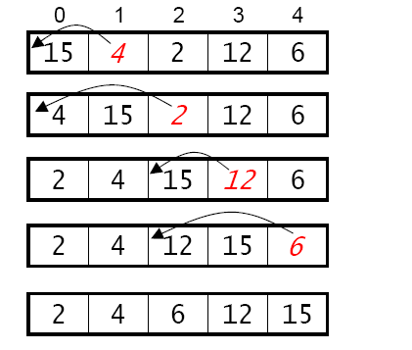
Method 2: Insertion Sort
Basic idea:
  going from left to right, “insert” each element into its proper place with respect to the elements to its left, “sliding over” other elements to make room.
An example:

Slide 11
Distinguishing Selection Sort and Insert Sort
Selection sort: loop through positions in the array and select the correct elements from the subsequent array to fill them
Insertion sort: loop through elements and determine where to insert them in the preceding array.
    16 8 13 2 15 9 4 12 24
An example that illustrates the difference:
  Sorting by selection:
    consider position 0: find the element (“2”) that belongs there
    consider position 1: find the element (“4”) that belongs there
    …
  Sorting by insertion:
    consider element “8”: determine where to insert it
    consider element “13”; determine where to insert it
    …
0 1 2 3 4 5 6 7 8

Slide 12
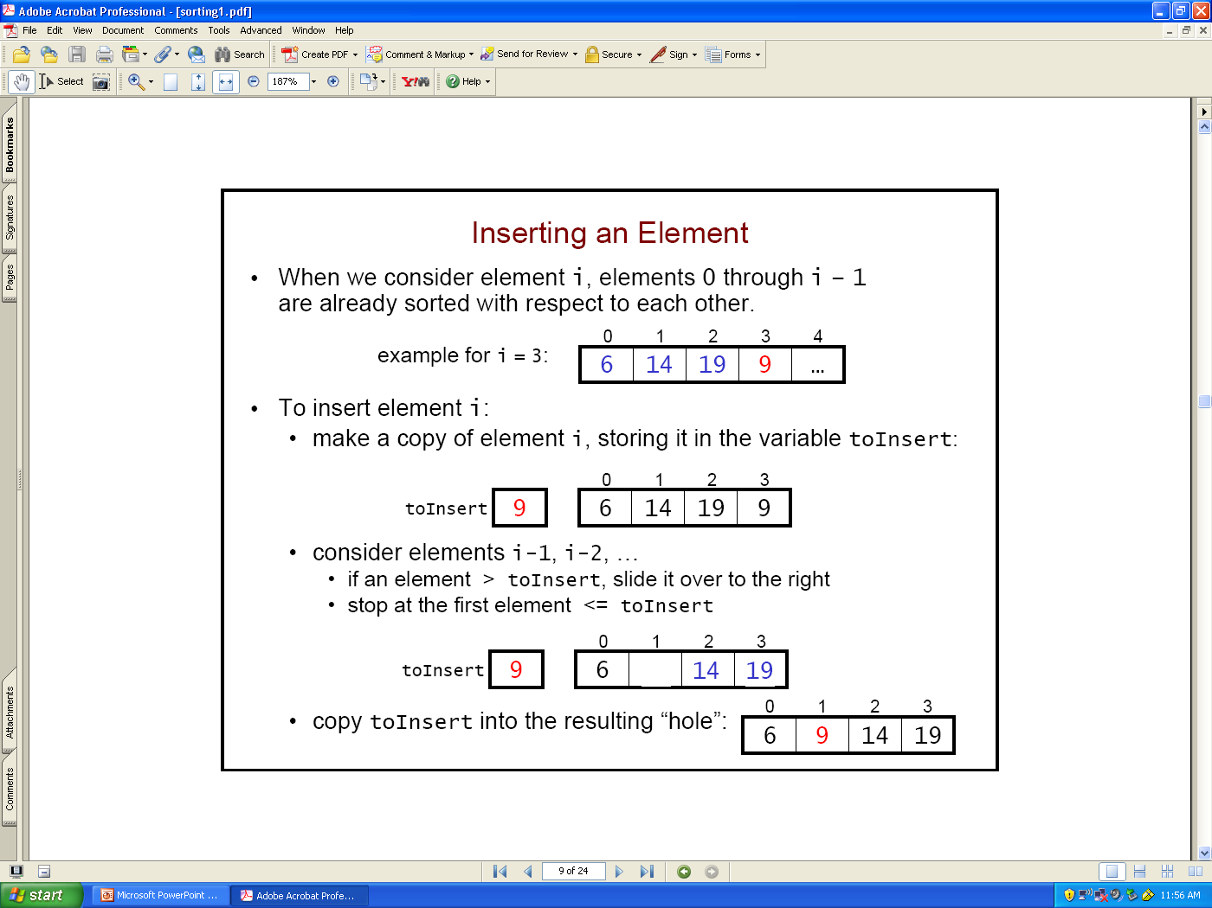
Inserting An Element
When we consider element i, elements 0 through i – 1 are already sorted with respect to each other.
  i = 3:
To insert element i:
  make a copy of element i, storing it in the variable toInsert:
  consider elements i-1, i-2, …
    if an element > toInsert, slide it over to the right
    stop at the first element <= toInsert
  copy toInsert into the resulting “hole”:

Slide 13
Implementation of Insertion Sort
0 1 2 3 4 5 6 7 8
16
4
15
7
8
10
2
3
5
static void insertionSort(int[] arr) {
  for (int i = 1; i < arr.length; i++) {
  int toInsert = arr[i];
  for (j = i; j > 0 && toInsert < arr[j-1]; j--)
  arr[j] = arr[j-1];
  arr[j] = toInsert;
  }
}

Slide 14
Running Time Analysis
The number of operations depends on the contents of the array.
  best case: array is sorted
    thus, we never execute the inner for loop
    each element is only compared to the element to its left
    C(n) = n – 1 = O(n), M(n) = 0, running time = O(n)
  worst case: array is in reverse order
    each element is compared to all of the elements to its left:
      arr[1] is compared to 1 element (arr[0])
      arr[2] is compared to 2 elements (arr[0] and arr[1])
      …
      arr[n-1] is compared to n-1 elements
    C(n) = 1 + 2 + … + (n – 1) = O(n²) as seen in selection sort
    similarly, M(n) = O(n²), running time = O(n²), compared to O(n) in selection sort
  average case: elements are randomly arranged
    each element is compared to half of the elements to its left
    still get C(n) = M(n) = O(n²), running time = O(n²)
static void insertionSort(int[] arr) {
for (int i = 1; i < arr.length; i++) {
  int toInsert = arr[i];
  for (j = i; j > 0 && toInsert < arr[j-1]; j--)
  arr[j] = arr[j-1];
  arr[j] = toInsert;
  }
}
0 1 2 3 4 5 6 7 8
0 1 2 3 4 5 6 7 8
2
3
4
5
7
8
10
15
16
16
15
10
8
7
5
4
3
2

Slide 15
An Improvement?
static void insertionSort(int[] arr) {
for (int i = 1; i < arr.length; i++) {
  int toInsert = arr[i];
  for (j = i; j > 0 && toInsert < arr[j-1]; j--) {
  arr[j] = arr[j-1];
  }
  arr[j] = toInsert;
  }
}
The array to the left of the current element is already sorted.
  Use binary search to find the proper position to insert toInsert!
  Would be log(n) comparisons per element.
Then what would be the running times in best/worst/average cases?

Slide 16
Selection Sort or Insertion Sort?
For sorted or nearly sorted arrays, insertion sort is much faster.
  insertion sort = O(n)
  selection sort = O(n²)
For random data, they are roughly equivalent (both O(n²))
  selection sort requires more comparisons
    selection = n²/2 - n/2 always
    insertion = n²/4 - n/4 in the avg case (O(nlog(n)) with optimization)
      when insertion enters the loop, it stops once arr[j] >= toCompare
  but insertion sort requires much more moves
    insertion = O(n²)
    selection = O(n)
For an array in reverse order, selection sort is faster than (non-optimized) insertion sort.
  why?

Slide 17
Method 3: Shell sort
Developed by Donald Shell in 1959
Improves on insertion sort, and takes advantage of the fact that insertion sort is fast when an array is almost sorted.
Also seeks to eliminate a disadvantage of insertion sort:
  if an element is far from its final location, many “small” moves are required to put it where it belongs.
  Example: if the largest element starts out at the beginning of the array, it moves one place to the right on every insertion!
    99 8 13 2 15 9 4 12 24
  Shell sort uses “larger” strides that allow elements to quickly get close to where they belong.
0 1 2 3 4 5 6 7 8

Slide 18
Shell Sort: Basic Ideas
Sorting Subarrays
  use insertion sort on interleaved subarrays that contain elements separated by some increment
  larger increments allow the data items to make quicker “jumps”
  repeatedly using a decreasing sequence of increments
Example for an initial increment of 3 (3 subarrays)
    99 8 13 2 15 9 4 12 24
Sort the subarrays using insertion sort to get the following:
    2 8 9 4 12 13 99 15 24
Finally, we complete the process using an increment of 1.
0 1 2 3 4 5 6 7 8
0 1 2 3 4 5 6 7 8

Slide 19
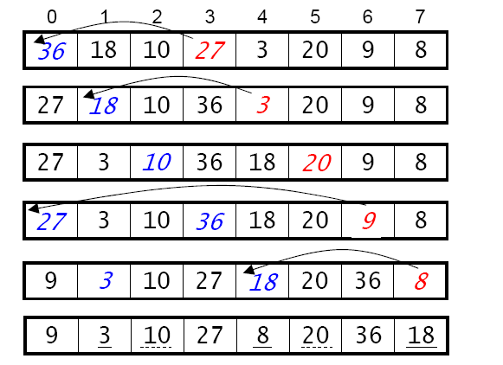
Single-Pass Shell Sort
We don’t consider the subarrays one at a time.
We consider elements arr[incr] through arr[arr.length-1], inserting each element into its proper place with respect to the elements from its subarray that are to the left of the element.
Example (increment = 3):

Slide 20
Choosing The Sequence of Increments
Different sequences of decreasing increments can be used.
  The last increment should be 1. A 1-sorted array is sorted; a 3-sorted array is only partially sorted.
A good sequence (Hibbard’s): one less than a power of two.
  2^{k} – 1 for some k: … 63, 31, 15, 7, 3, 1
  Can get the next lower increment using integer division:
    incr = incr/2;
The sequence of increments should avoid numbers that are multiples of each other.
  A bad sequence: … 64, 32, 16, 8, 4, 2, 1

Slide 21
Implementation of Shell Sort
static void shellSort(int[] arr) { // Using Hibbard’s sequence
  int incr = 1;
  while (2 * incr <= arr.length) incr = 2 * incr;
  incr = incr - 1;
  while (incr >= 1) {
    for (int i = incr; i < arr.length; i++) {
        int toInsert = arr[i];
        for(j = i; j > incr-1 && toInsert < arr[j-incr]; j = j - incr)
        arr[j] = arr[j-incr];
        arr[j] = toInsert;
    }
    incr = incr/2;
  }
}
The highlighted code is from insertionSort() except that incr replaces 1

Slide 22
Running Time of Shell Sort
Depends on the sequence of decreasing increments
  Should decrease fast to lower the number of passes of insertion sort
  Should not decrease too fast or will be close to (one-pass) insertion sort
Hibbard’s sequence has worst-cast running time at O(n^{3/2}); similar to
(Case Alum) Knuth’s sequence: … 1093, 364, 121, 40, 13, 4, 1
    incr = incr/3;
Sedgewick’s sequence: … 109, 41, 19, 5, 1
  interleave 9*4^{i} - 9*2^{i} + 1 and 4^{i} - 3*2^{i} + 1
  worst-case running time O(n^{4/3})
The running time is often difficult to analyze, and some bounds are unknown.
  The average-case running time for Hibbard or Sedgewick sequences? -- Unknown!
  What is the best sequence of increments? – Unknown!

